Slide 1
Toraberu – How to Delete User
August 15, 2024
KHI Design & Technical Service, Inc.

Slide 2
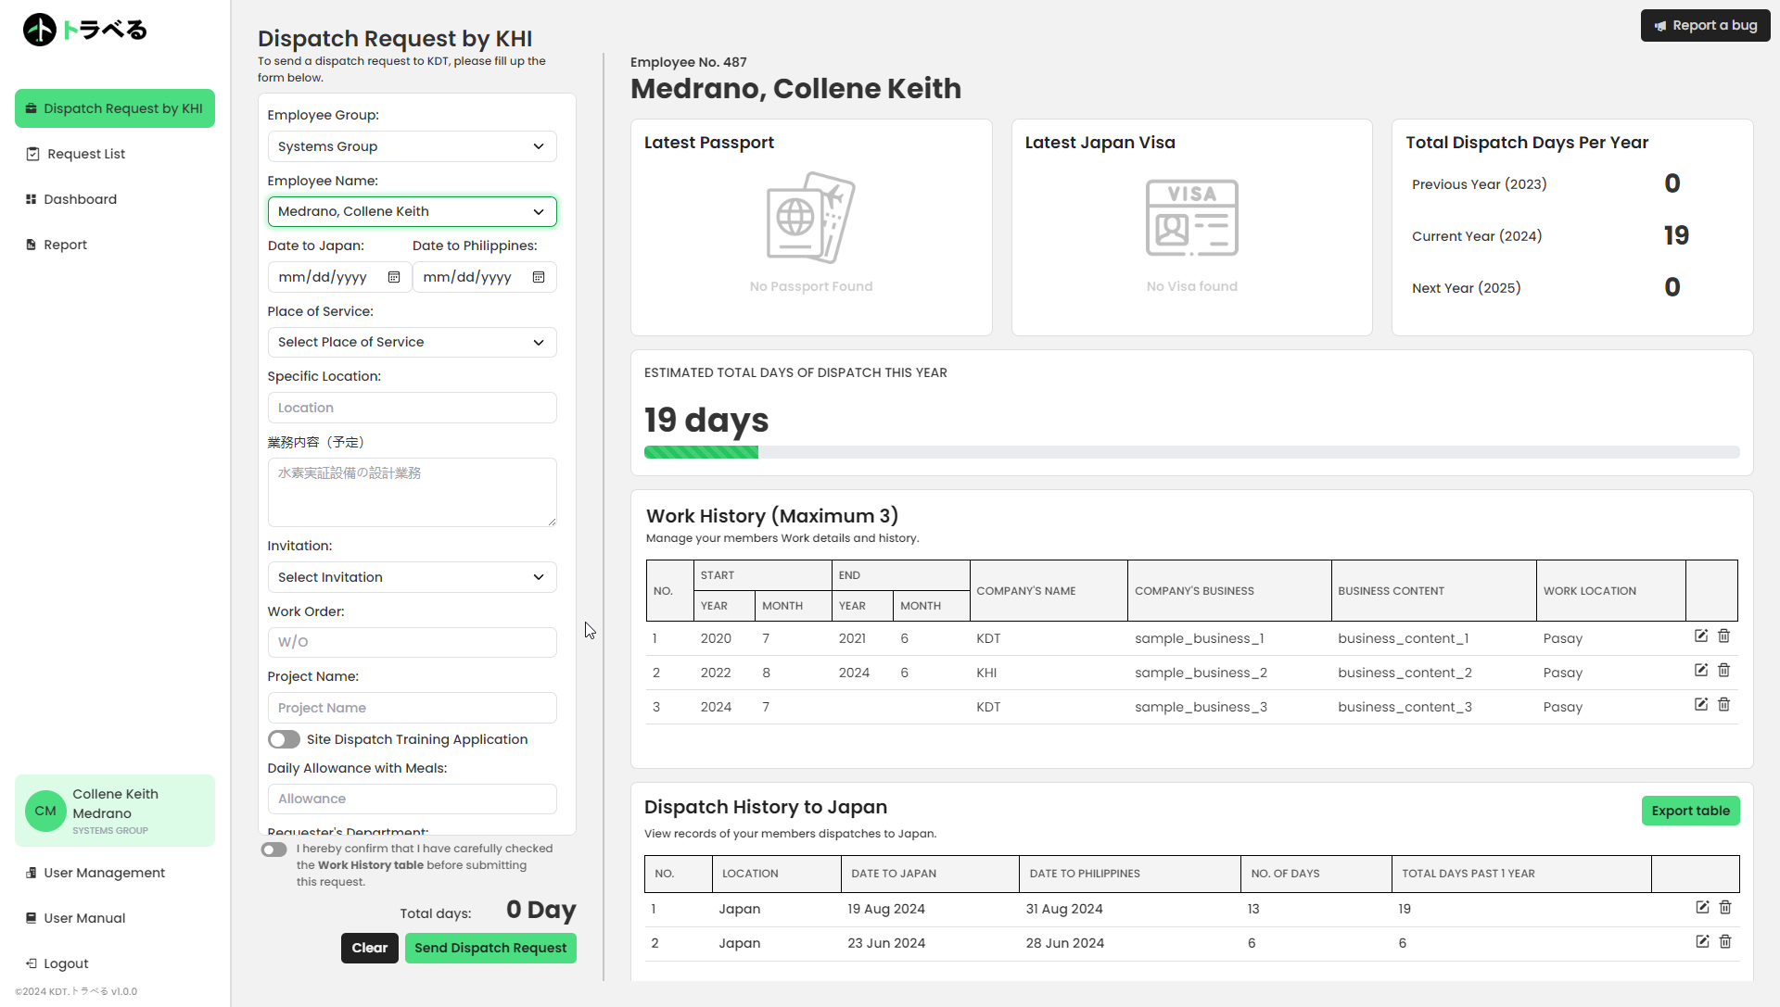
1. Click on the User Management Tab below your Profile
Click

Slide 3
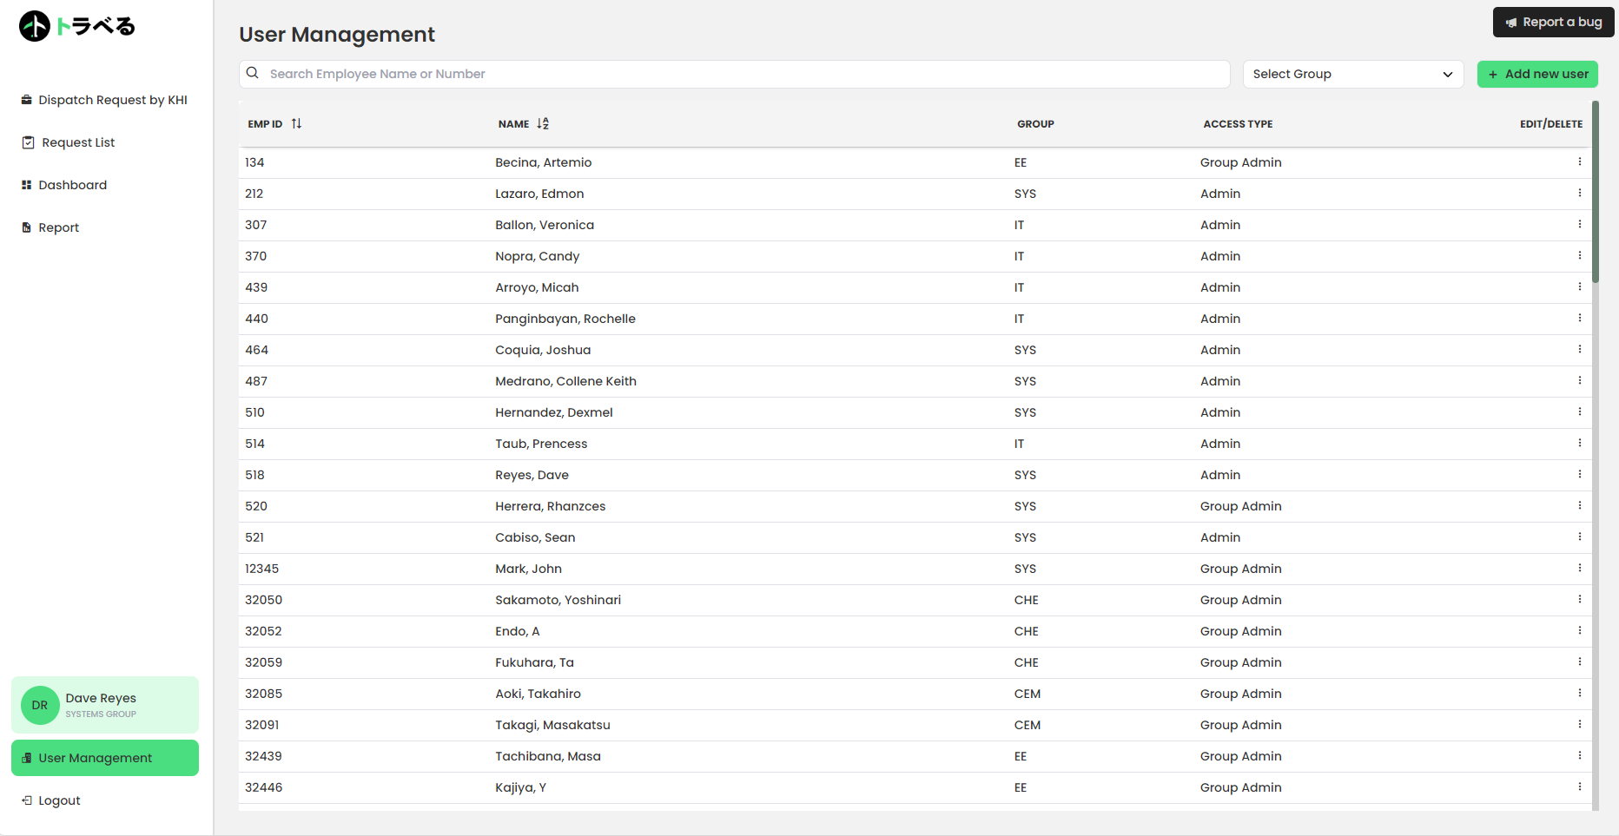
2. Click the Kebab Menu Button
Click

Slide 4
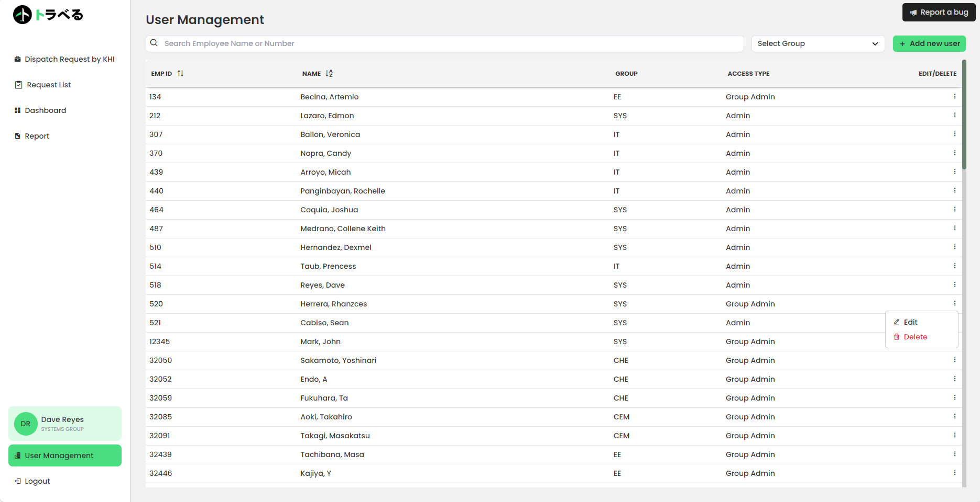
3. Click the Delete Button
Click

Slide 5
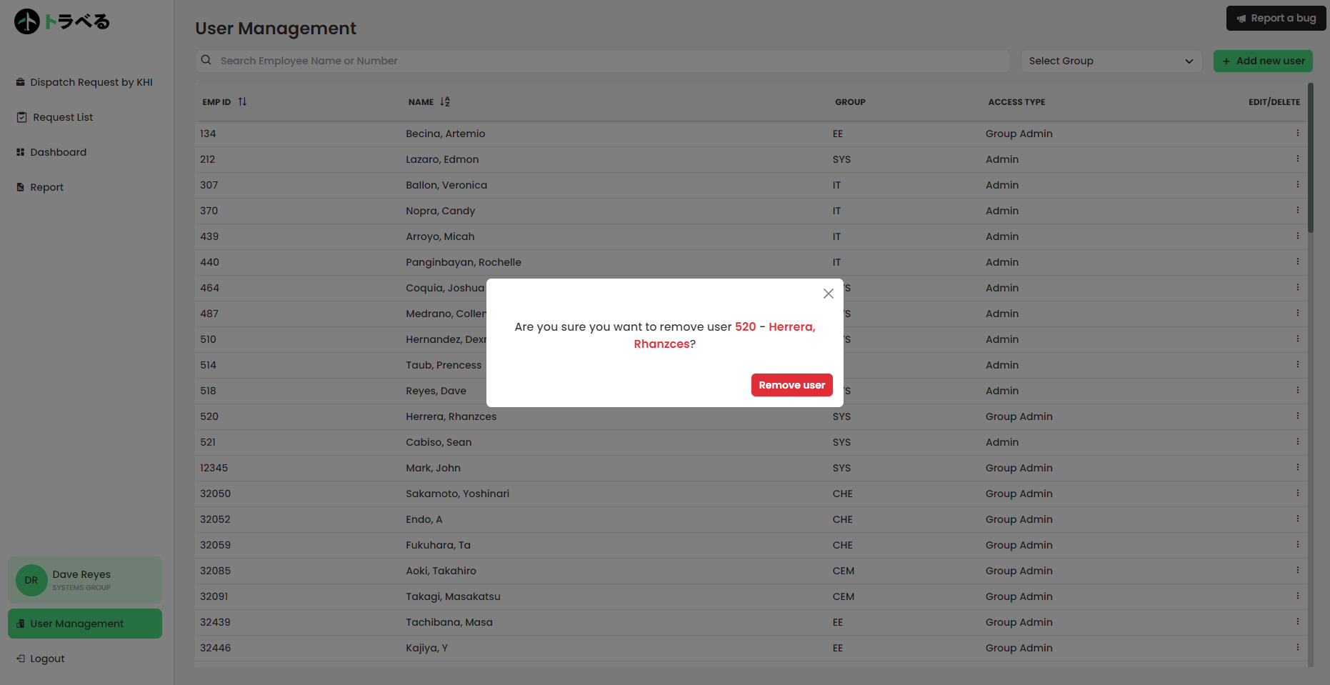
4. Click the Remove User Button
Click

Slide 6
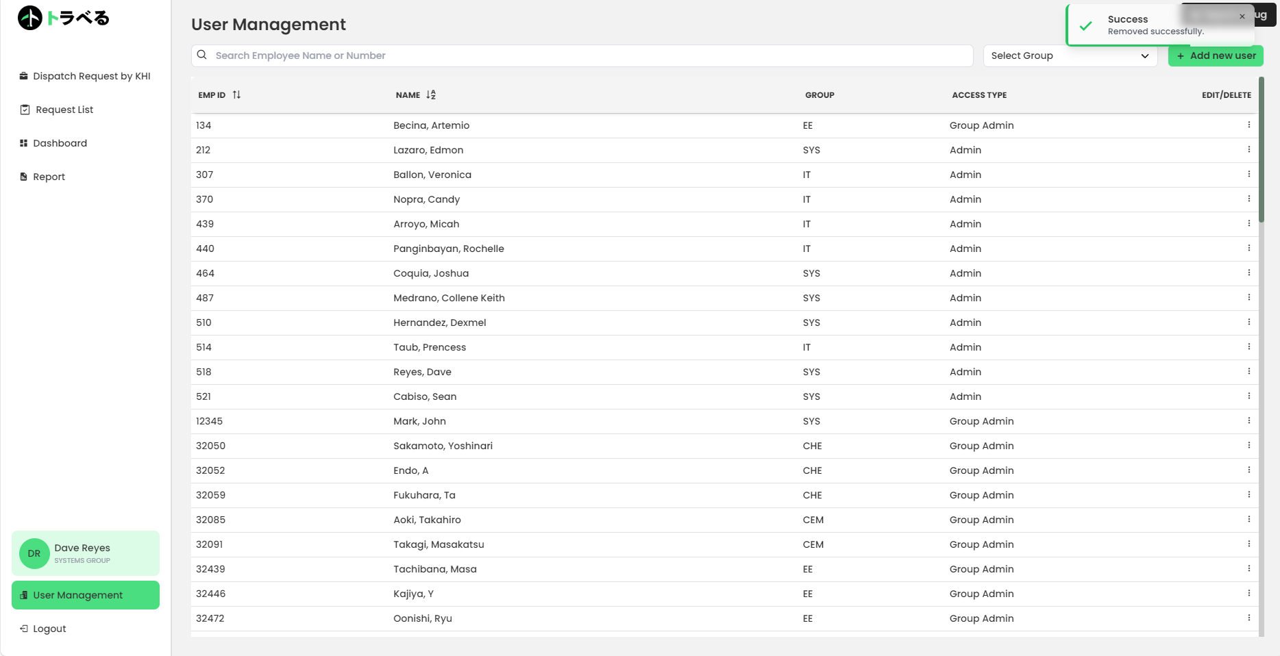
5. Check for Confirmation and if User is added to the Group
This will pop-up if user is successfully removed
User will also disappear in the list

Slide 7



